Slide 1
Ahmed Safwat
Web developer student at GoMyCode

Slide 2
About me
I’m passionate about building great products that make people’s lives easier. Before getting to programming i was a photoshop graphic designer but i wanted to dive into programming so i made that website that supports all types of art talented people hope yall like it.
I grew up in Egypt, am a web developer, and I’m excited to partner with you!

Slide 3

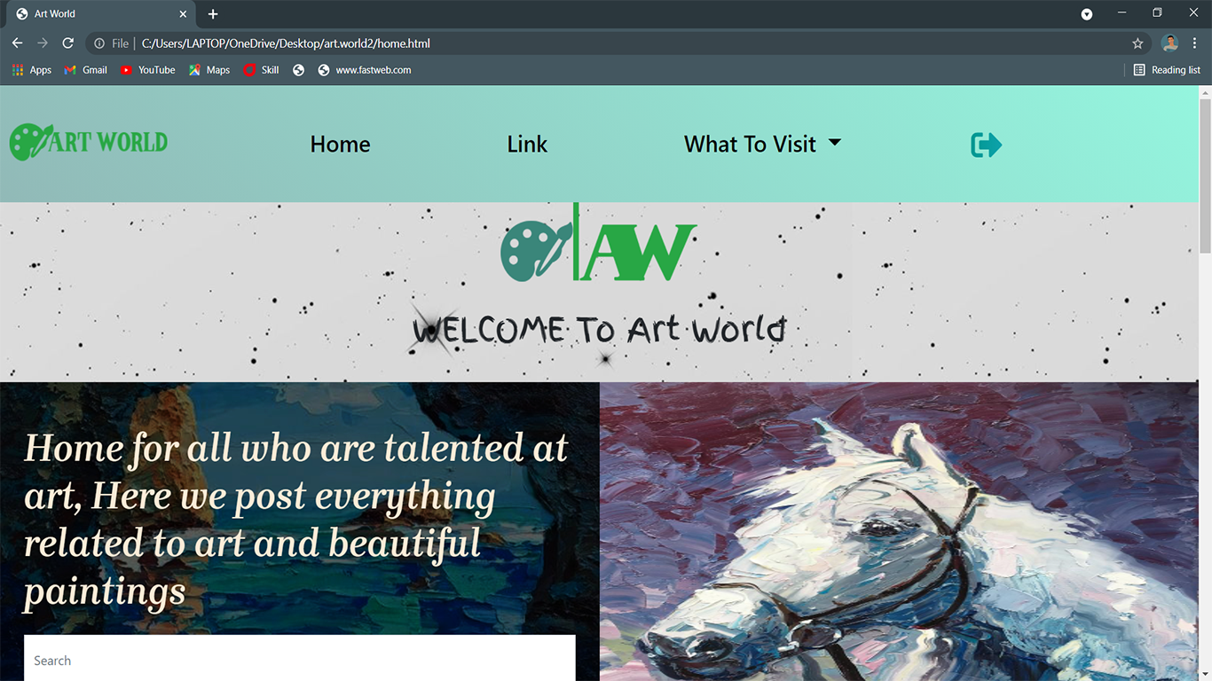
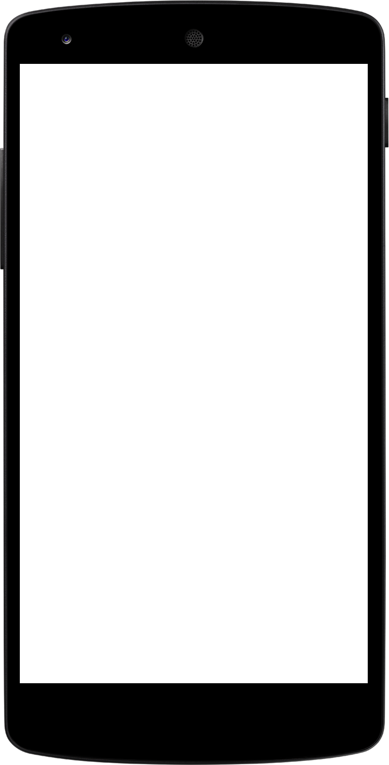
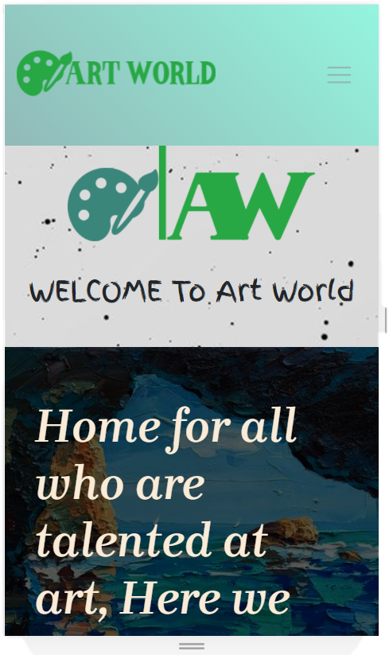
Art world
Hello everyone!, I’m Ahmed safwat today I’m presenting you my website made by me

Slide 4
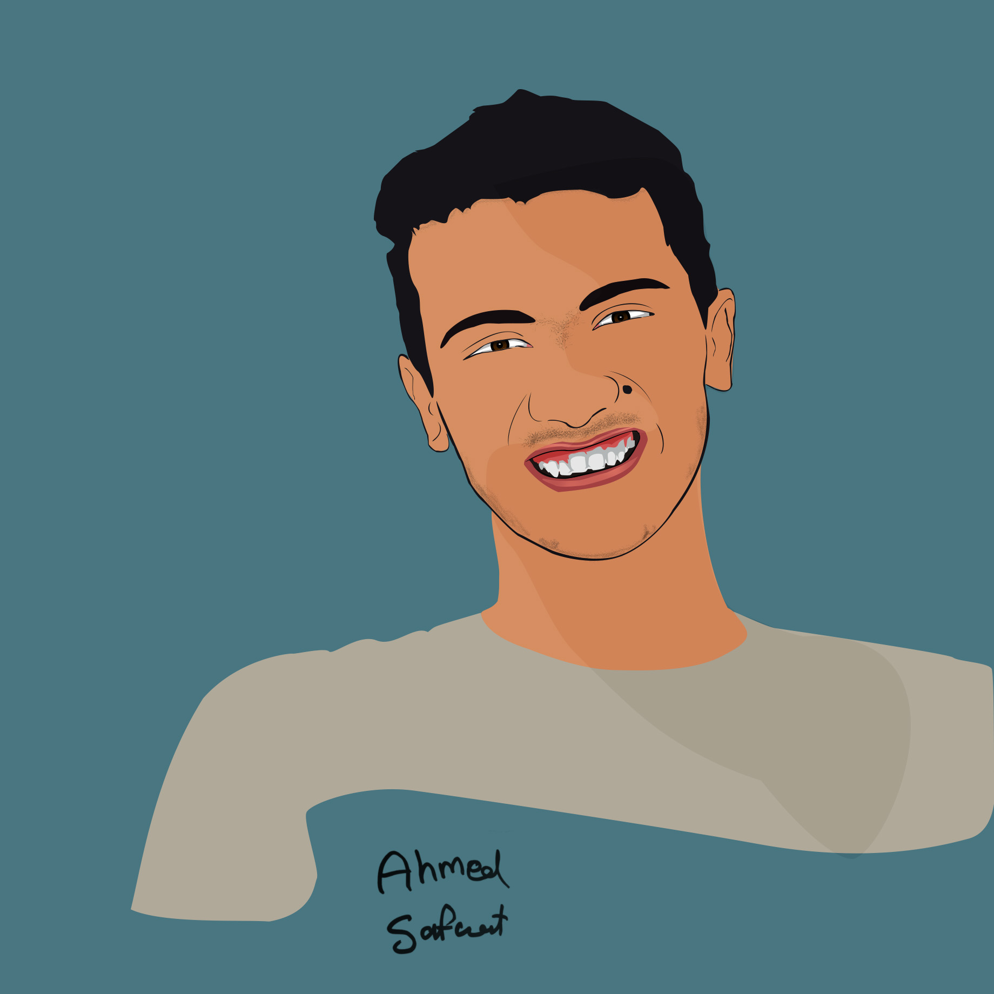
Contact
Ahmed Safwat
Email:
ahmedsafwat412@gmail.com
Phone number:
01095048748

